Slide 1
IT-OT Convergence
IT-OT Risk & Controls

Slide 2
Cybersecurity Policy for the US Federal Government
In 2002, the Federal Information Security Management Act became law.
  Modernization of Federal IT policy delegated to the Office of Management and Budget (OMB)
  Cybersecurity Regulations delegated to National Institute of Standards and Technology (NIST)
    NIST Regulations apply to all Federal Agencies, Departments, etc.
In 2014, the Federal Information Security Modernization Act became law.
  Gave authority for Information Security policy implementation oversight to Department of Homeland Security (DHS).
  Clarified, Adjusted the Office of Management and Budget (OMB) role to be policy development.
So... FISMA (2002) and FISMA (2014)

Slide 3
Connecting NIST to State Governments and Industry
If FISMA is for Federal Government Agencies, why does anyone else care?
  NIST Regulations get applied to contractors retained by the Federal Government.
    Contractors want to do business with the Federal Government
    State Governments and businesses want Federal Grants
  NIST Regulations are often used as "best practice" documents for industry.
    NIST Regulations are very thorough and complete.
Yes, it is true...
  A company with no Federal contracts could ignore NIST.
  A company may embrace some other framework.
    There are other good frameworks and standards: CIS Top 18, ISO 27000, etc.
    You're not wasting your time studying NIST documents
      Other frameworks have similar controls; just organized differently.

Slide 4
Why do I need to know these documents?
Because there's too much information to remember.
  How many telephone numbers do you have memorized?
  Did you memorize the capital of Malta? (Valletta, by the way. Yes, I had to look it up.)
Because there's too much information to cover in lecture.
You need to use the documents to complete assignments.
You need to use the documents to find answers for exams.
On the job, you would need the documents to answer similar questions.
  Cybersecurity professionals use these docs.
  This is the real thing, not an academic exercise.

Slide 5
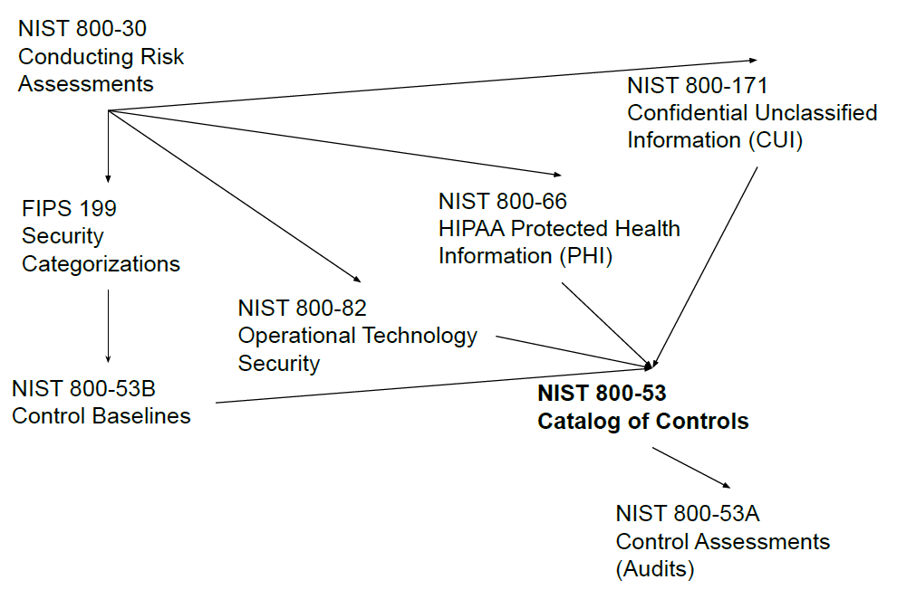
Document Summary
Assess Risk
  800-30
Select Existing Baseline:
  800-66, or
  800-82, or
  800-171
Or Custom Baseline:
  FIPS 199, and
  800-53B, and
  Expert Judgment
Implement Controls
  800-53
Assess Controls
  800-53A

Slide 6
Risk Refresher
Asset - Something of value such as data, systems, facilities, and people.
Vulnerability - Weakness that could be exploited to compromised an asset.
Threat - Any circumstance or event with the potential to exploit a vulnerability and harm an asset.

Slide 7
Risk Refresher
Likelihood - Probability of a threat will exploit a vulnerability.
Impact - The magnitude of harm if a threat successfully exploits a vulnerability and harms an asset, typically measured in monetary value such as the cost of recovery.
Risk - The combination of likelihood and impact. Risk = Likelihood x Impact
Reminder:
  If Likelihood is 0%, then there is no Risk. If Impact is 0, then there is no Risk.

Slide 8
Assess Risk (800-30)
NIST devotes several documents to Risk Assessment and Management:
  NIST 800-30 - Risk Assessment Guidance
  NIST 800-37 - Risk Management Framework
  NIST 800-39 - Enterprise Risk Management
Risk Analysis as a Subjective Estimation
  Asking subject matter experts for "gut feeling" estimates.
  Classic approach, typically inconsistent and inaccurate.
Risk Analysis as Empirically-Informed Estimation
  Data Driven approach to using real-world loss data based on an industry's history.
  Modern approach, can still suffer from incomplete and biased data.

Slide 9
Document Summary
Assess Risk
  800-30
Select Existing Baseline:
  800-66, or
  800-82, or
  800-171
Or Custom Baseline:
  FIPS 199, and
  800-53B, and
  Expert Judgment
Implement Controls
  800-53
Assess Controls
  800-53A

Slide 10
Existing Baselines
Healthcare Records (HIPAA) = NIST 800-66
Confidential Unclassified Information (CUI) = NIST 800-171
  Student Data (FERPA)
  Personally Identifiable Information (PII)
  Federal Taxpayer Information (FTI)
Critical Infrastructure / Operational Technologies = NIST 800-82
A baseline tells you specifically which Controls in 800-53 are suggested.

Slide 11
Document Summary
Assess Risk
  800-30
Select Existing Baseline:
  800-66, or
  800-82, or
  800-171
Or Custom Baseline:
  FIPS 199, and
  800-53B, and
  Expert Judgment
Implement Controls
  800-53
Assess Controls
  800-53A

Slide 12
NIST Standard: FIPS 199
Federal Information Processing Standards Publication 199 (FIPS 199)
  https://csrc.nist.gov/files/pubs/fips/199/final/docs/fips-pub-199-final.pdf (13 Pages)
  Resources: FIPS-Pub-199-Final.pdf
Establishes a way to Categorize Information Systems based on:
  Confidentiality - Restricting access to protect privacy and information of value.
  Integrity - Protection against unwanted modification or destruction.
  Availability - Ensure the system and data can be used.
Establishes a Potential Impact rating:
  Low - limited adverse effect
  Moderate - serious adverse effect
  High - severe or catastrophic adverse effect

Slide 13
NIST Standard: FIPS 199
To rate an information system:
  Rate the Impact for Confidentiality (Low, Moderate, High, or Not Applicable)
  Rate the Impact for Integrity (Low, Moderate, High, or Not Applicable)
  Rate the Impact for Availability (Low, Moderate, High, or Not Applicable)
  The Security Categorization is the highest rating it the system's rating, no lower than "Low".
Example: A web server with public information:
  Confidentiality: Not Applicable
  Integrity: Moderate
  Availability: Moderate
  Thus, Security Categorization: Moderate.
How is knowing this useful? Baselines. (NIST 800-53B)

Slide 14
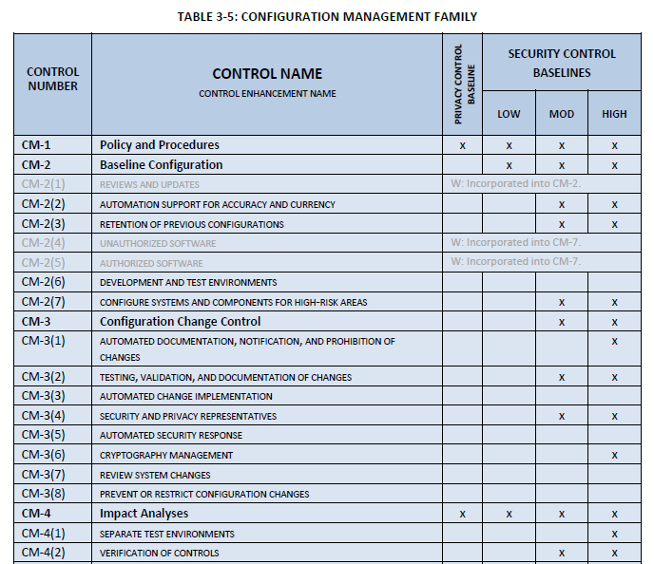
NIST 800-53B (Baselines)
Start with a Security Categorization
from FIPS 199, Example: Moderate
Find all the X's in the column.
This tells you which Controls
are suggested.
  (Expert Judgment can add/remove controls.)
So CM-3 is a control?
  Yes, the "Configuration Change" control.

Slide 15
Document Summary
Assess Risk
  800-30
Select Existing Baseline:
  800-66, or
  800-82, or
  800-171
Or Custom Baseline:
  FIPS 199, and
  800-53B, and
  Expert Judgment
Implement Controls
  800-53
Assess Controls
  800-53A

Slide 16
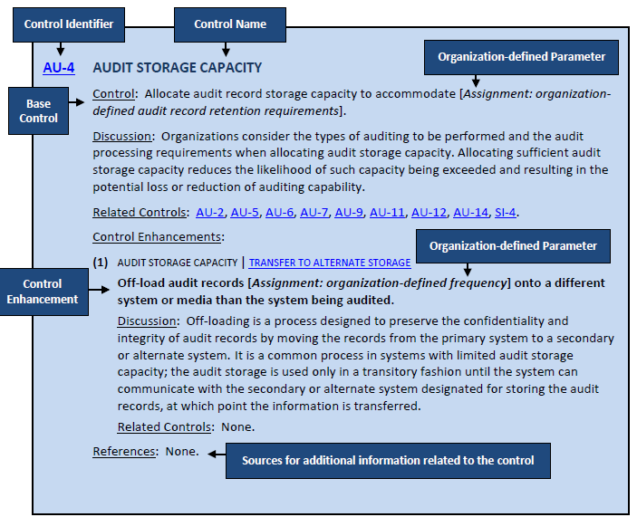
NIST 800-53 - The Catalog of Controls
Base Control Description
  Control Identifier: AU-4
  Control Name: Audit Storage Capacity
  Discussion: English description.
    Requires some interpretation.
      (A good reason to come to class.)
      This is talking about log files.
  Related Controls: Handy Reference
Parameters
  [Assignment: Organization]
  [Assignment: Organization Defined Frequency]
  These are blanks to be filled.

Slide 17
NIST 800-53 - The Catalog of Controls
Control Enhancement
  AU-4(1) << The (1) denotes the enhancement.
  There can be multiple enhancements, so...
    (2), (3), (4), etc.
  Enhances, Modifies, Extends the base control.
  Can have Parameters just like a base control.
  Discussion, just like a base control.

Slide 18
Document Summary
Assess Risk
  800-30
Select Existing Baseline:
  800-66, or
  800-82, or
  800-171
Or Custom Baseline:
  FIPS 199, and
  800-53B, and
  Expert Judgment
Implement Controls
  800-53
Assess Controls
  800-53A

Slide 19
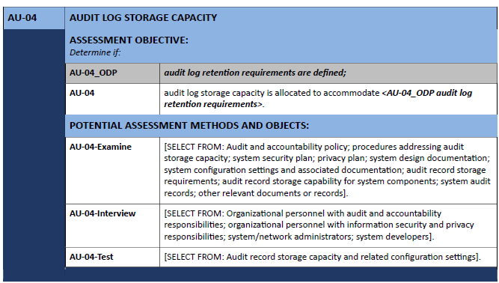
NIST 800-53A - Assessment of Controls (Auditing)
Describes how to Assess (Audit) a Control
Examine:
  A list of things to examine.
  Pick one or more.
Interview:
  A list of people to interview.
  Pick one or more.
Test:
  Test that can be performed to
  see if the control is functioning
  as intended.
  Pick one or more.

Slide 20
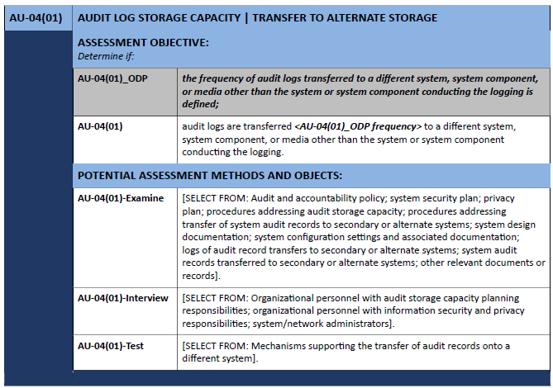
NIST 800-53A - Assessment of Controls (Auditing)
Also describes how to test Control Enhancements.
Same approach as a Control.

Slide 21
What is NIST 800-82r3?
NIST 800-82 (revision 3) applies that foundation to Operational Technologies
Guidance for mitigating cybersecurity risks to OT systems:
  Covers ISC, SCADA, Distributed Control Systems, OT Environments
  Addresses unique IT constraints: real-time requirements, legacy systems
  Recognizes OT failures can have physical and safety consequences
  Aligns with NIST CSF and NIST 800-53 controls
  Discusses establishing Cybersecurity Programs

Slide 22
OT Cybersecurity Programs (from NIST 800-82)
Organizations need to develop cybersecurity programs with these elements:
Create a Charter
  Senior Leadership - Provide funding, visibility, governance, and support.
  Put somebody in charge and hold them accountable for the cybersecurity program.
  Define and document:
    objectives, scope, and responsibilities.
    responsibilities of system owners and process managers.

Slide 23
OT Cybersecurity Programs (from NIST 800-82)
Establish a Business Case - Link cybersecurity to benefits
  Improve safety, reliability, availability, and perhaps efficiency
  Reduce legal liabilities and insurance costs; satisfy regulatory requirements
  Highlight potential costs of system failures:
    Physical impacts
    Economic impacts
    Social impacts

Slide 24
OT Cybersecurity Programs (from NIST 800-82)
Build the Cybersecurity Program
  Establish a Governance structure:
    administrative policies, procedures, processes
    roles and responsibilities
    legal and regulatory requirements
    identification and management of risk
  Assemble a team with cross-functional expertise.
    Control Engineers
    IT Staff
    Security Experts
    Risk Managers

Slide 25
OT Cybersecurity Programs (from NIST 800-82)
Build the Cybersecurity Program (continued)
  Define the OT Cybersecurity Strategy
    Take into account organizational risk management strategies.
    Decide to insource / outsource / use cybersecurity services.
    Decide upon cybersecurity architectures.
    Define cybersecurity training and awareness efforts.
  Define OT-Specific Policies and Procedures
    These are operational policies and procedures, specific to operations.
  Build a Cybersecurity Awareness and Training Program for OT
    Train employees, contractors, consultants, and onsite vendors.

Slide 26
OT Cybersecurity Programs (from NIST 800-82)
Build the Cybersecurity Program (continued)
  Implement a Risk Management Framework for OT
    NIST 800-39 describes Risk Management
      Risk Framing
        Organizational, Mission, and System Risks
        Risk Tolerance
      Risk Assessment
      Risk Responses
      Risk Monitoring
  Supply Chain Risk
    Interruptions to production; interruptions to consumer services
    NIST 800-161 covers Supply Chain Risk Management

Slide 27
OT Cybersecurity Programs (from NIST 800-82)
Build the Cybersecurity Program (continued)
  Develop a Maintenance Tracking Capability
    Perform routine and preventative maintenance
    Track that maintenance
    Require access is controlled for remote maintenance capabilities
  Develop an Incident Response Capability
    Plan for incident detection, containment, and reporting.
    Build capabilities for:
      incident management
      forensic analysis
      vulnerability management
      incident response

Slide 28
OT Cybersecurity Programs (from NIST 800-82)
Build the Cybersecurity Program (continued)
  Develop a Recovery and Restoration Capability
    Business Continuity Plan (BCP) and Disaster Recovery Plan (DRP)
    Backup systems, restoration processes
    Public relations / communication plans

Slide 29
NIST Interagency Report 8183 (NIST IR 8183)
Developed as a collaboration between Government and the Private Sector
A Voluntary, Risk-Based, Profile for a Cybersecurity Framework (CSF) implementation of a Manufacturing Environment
  The Cybersecurity Framework is strategic and organizational.
  NIST 800-53 is a tactical and technical document.
So, NIST IR 8183 and the CSF Enhances, Not Replaces:
  Cybersecurity Standards
  Industry Guidelines, Industry Best Practices

Slide 30
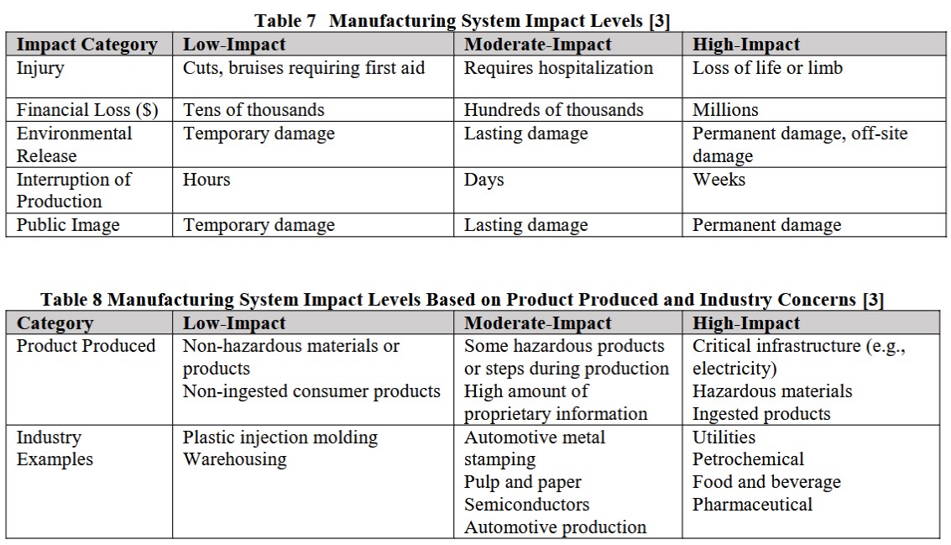
NIST IR 8183 - Risk Levels

Slide 31
CSF's Framework Core and NIST IR 8183
CSF (and thus NIST IR 8183) promote these Functions:
  Identify (ID) - Develop an understanding of your organization's assets, data, and capabilities so you know what you are protecting and why.
  Protect (PR) - Implement controls to address elements of risk (likelihood, magnitude).
  Detect (DE) - Identify when a cybersecurity event has occurred in a timely manner.
  Respond (RS) - Take action to contain a cybersecurity event once detected.
  Recover (RC) - Restore capabilities; return to normal operations.

Slide 32
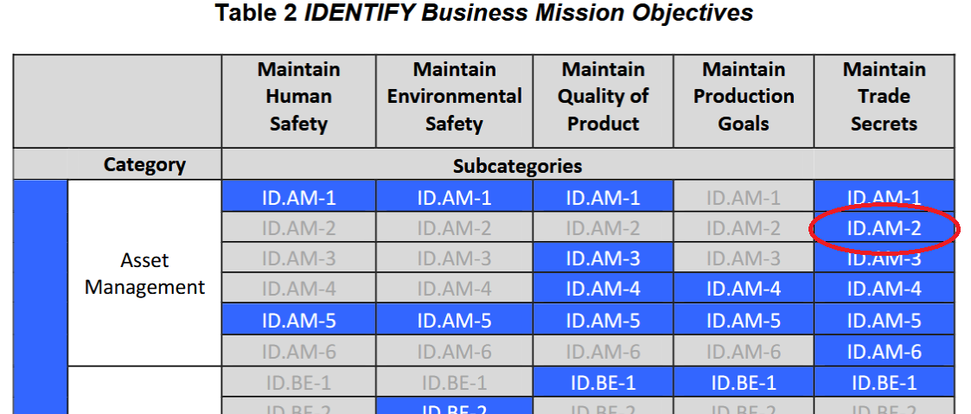
NIST IR 8183 CSF to NIST 800-53 Crosswalk

Slide 33
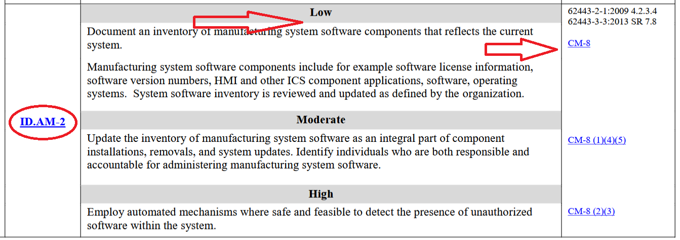
NIST IR 8183 CSF to NIST 800-53 Crosswalk

Slide 34
NIST Baseline Navigator Application
This application has the potential to be:
  A classroom exercise.
  Homework.
https://www.its.ohio.edu/tong/iz/nist-documentation/index.html

