Slide 1
IT-OT Convergence
Introduction to ICS Architecture

Slide 2
Do You Remember?
Sensors and Actuators
Control Loop
Programmable Logic Controller (PLC)
Remote Terminal Unit (RTU)
Human Machine Interface (HMI)
Supervisory Control and Data Acquisition (SCADA)
Distributed Control System (DCS)
Building Automation System (BCS)

Slide 3
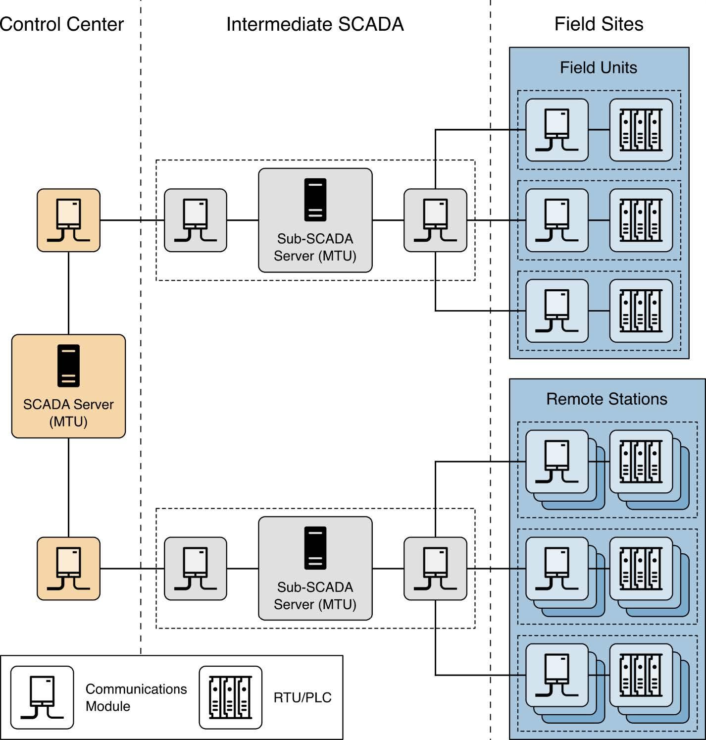
Implementation Example
A Conceptual Model
  Shows SCADA centrally located.
  Shows PLCs at other locations.

Slide 4
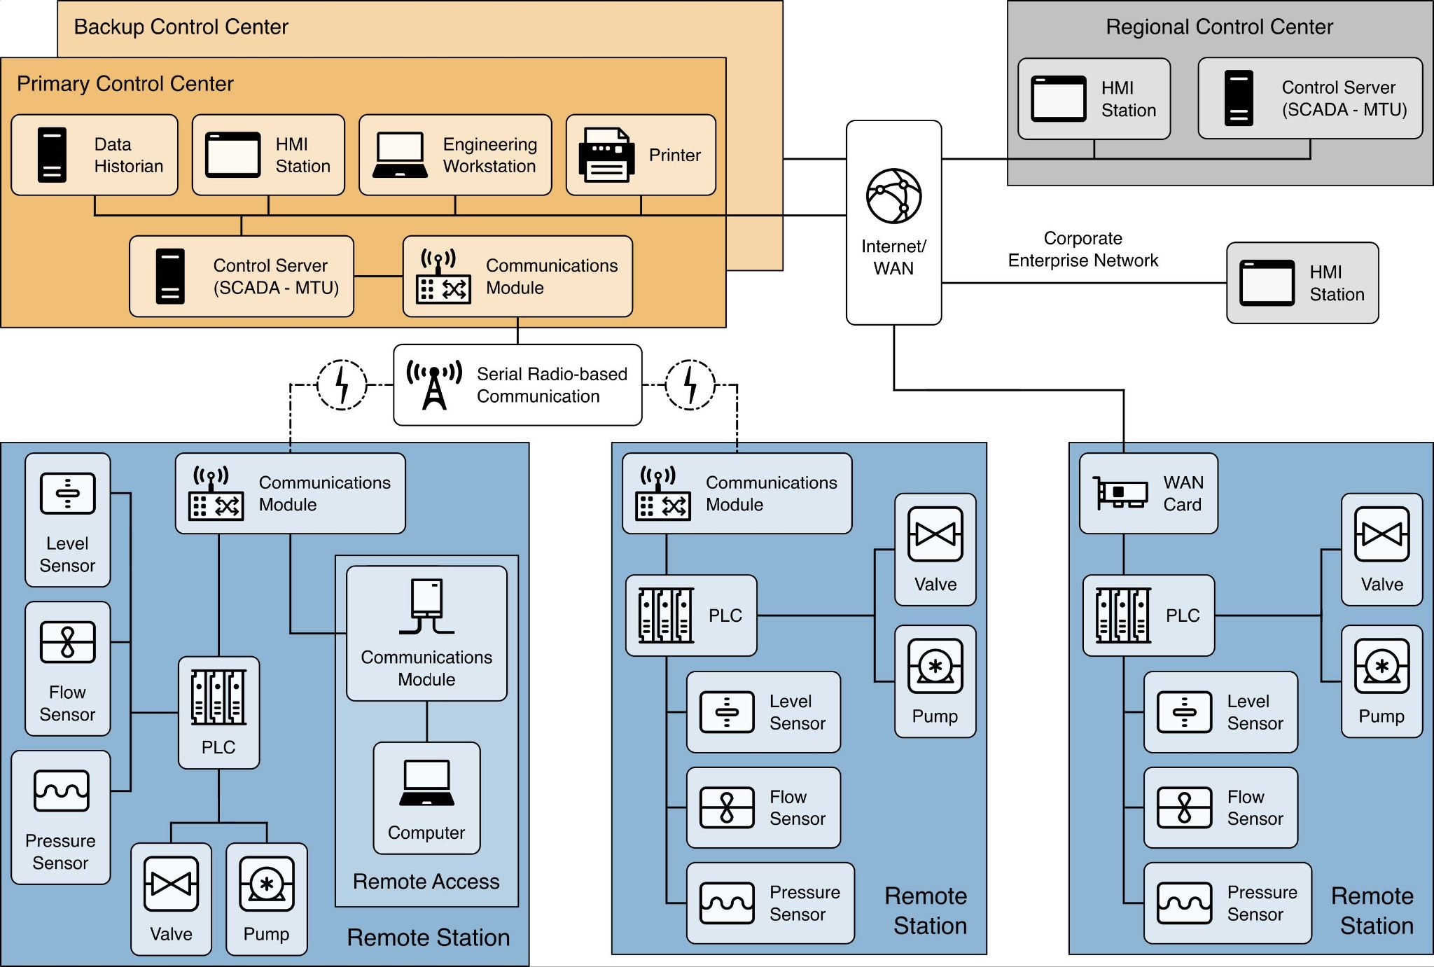
Implementation Examples
Comprehensive Example
  Central SCADA
  Variety of Communications
  Paths w/Internet
  PLCs
    Sensors
    Actuators

Slide 5
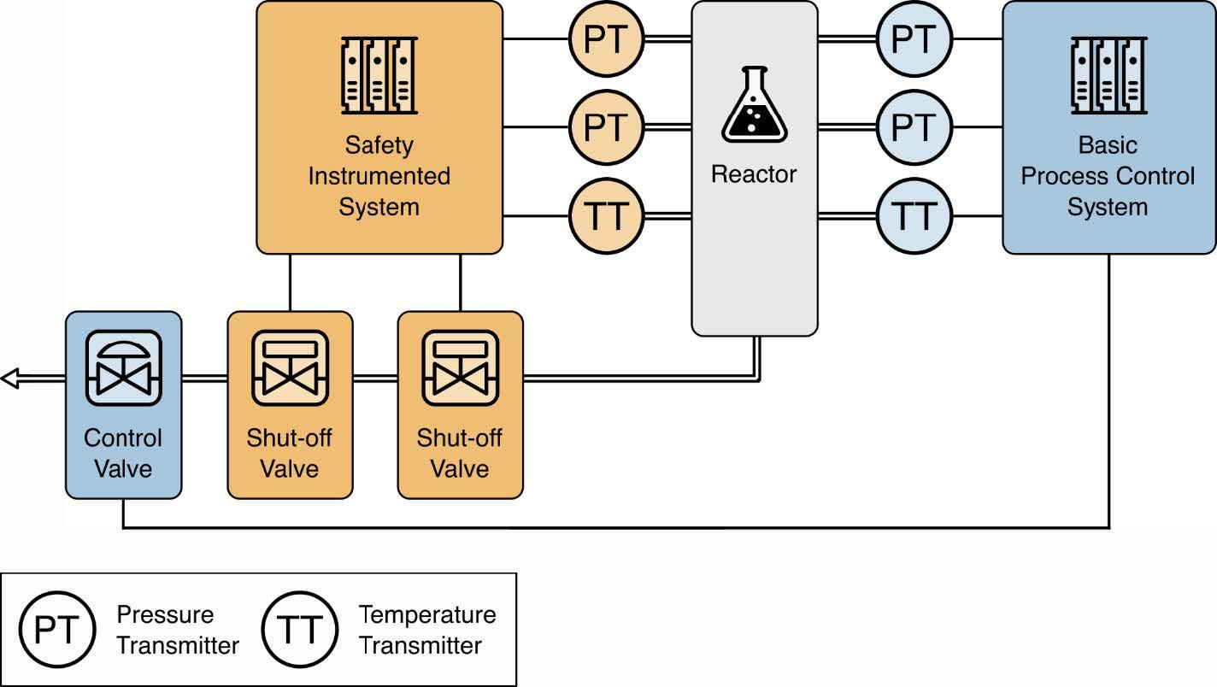
Implementation Examples
Safety System Example (Nuclear Reactor)
Diagram shows two systems:
  One for the operators to control the reactor.
  Another that independently monitors the reactor.
    When safety parameters are exceeded it returns the system to a safe state.
    Has its own sensors, controllers, and actuators.
Cybersecurity Implications:
  If the operator's system is compromised, the safety system can still override.
  An attacker would have to compromise both systems.
    (Triton malware disabled a safety system at a Saudi Arabian petrochemical plant.)

Slide 6
OT System Security Considerations:
Time Critical
  Cannot tolerate delay (latency) or variance in that delay (jitter).
High Availability and Reliability
  Devices remain functional for long period of time. Interruptions can cascade.
Safety
  If you think of the classic Confidentiality-Integrity-Availability, then add Safety for OT.
  If you're already thinking of CIANA+PS, then you're already including Safety.

Slide 7
OT System Security Considerations:
Physical Consequences
  Oil Spillage is much different than Data Spillage...
System Operation
  Different skill sets are involved in managing these systems: Control Engineers.
Resource Constraints
  Legacy systems may lack processing capacity needed for newer applications.

Slide 8
OT System Security Considerations:
Communications
  OT can involve communication protocols and methods unfamiliar to IT personnel.
Change Management
  IT systems can enjoy automated deployments of patches.
  OT systems require downtime to apply patches scheduled far in advance.
  OT systems may be so old they are no longer receiving patches from the vendor.
Managed Support
  Support likely only available from one source.
  Support agreements with vendors may preclude certain security solutions.

Slide 9
OT System Security Considerations:
Component Lifetime
  IT components typically last 3 to 5 to maybe 10 years.
  OT components typically last 10 to 15 to maybe 30 years.
  You cannot retrofit modern security features into legacy technologies.
Component Location
  IT components typically run in environmentally controlled areas: offices, data centers.
  OT components run in dirty, harsh, and remote locations.

Slide 10
Defense in Depth: Layers
Defense in Depth is the prevailing strategy for cybersecurity.
  Put forth by the National Security Agency (NSA) part of the Department of Defense.
  This is an application of a classic military strategy.
    If you defend only the front line, a breach leads to being outflanked.
Layer 1 - Security Management
  The cybersecurity program we just discussed.

Slide 11
Defense in Depth: Layers
Layer 2 - Physical Security
  Exterior: fences, walls, ditches / mounds, barricades, gates, doors,guards, etc.
  Interior: locked cabinets and interior doors
  Keeping PLCs in "Run" mode, not in "Program" mode.
  Access monitoring and control systems
  People and Asset tracking

Slide 12
Defense in Depth: Layers
Layer 3 - Network Security / Architecture
  Boundary protection (exterior)
  Network segmentation (interior; lateral movement)
    Corporate network; Corporate DMZ
    Operational network; Operational DMZ
    Zero-Trust Architecture (ZTA)
    Location of wireless access points within the network
  Monitoring capabilities
  Logging capabilities

Slide 13
Defense in Depth: Layers
Layer 4 - Hardware Security
  Establishing trust of devices
  Maintaining state
  Configuration hardening
Layer 5 - Software Security
  Patching
  Allowlisting
  Secure code development; development practices
  Application configuration hardening

Slide 14
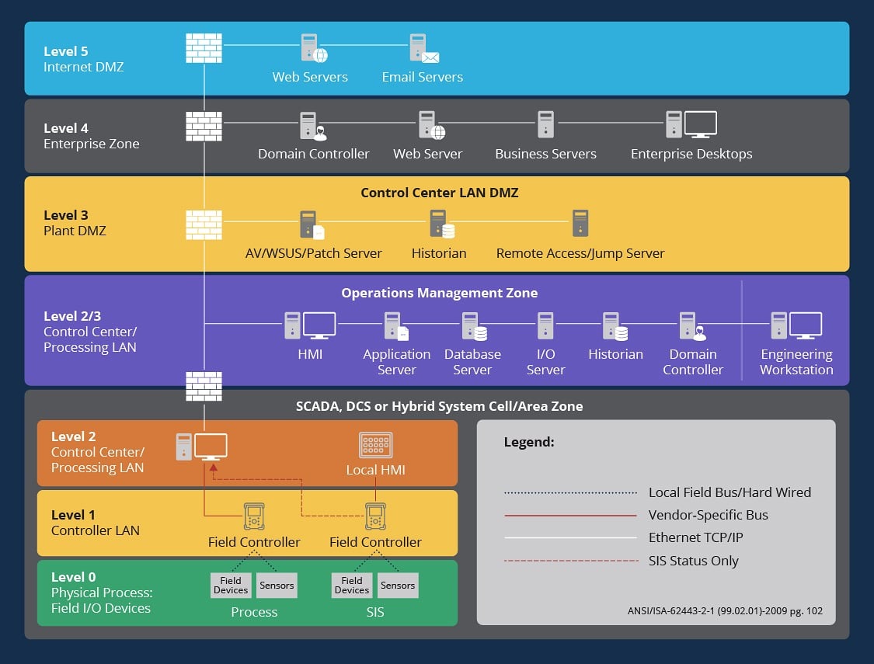
OT Network Architecture - "Purdue Model"
Levels 4-5: Classic IT
  Isolate business from the Internet
Level 3: DMZ between IT/OT
  Isolate OT from the business
  but allow for protected control
Levels 0-2: OT
  Classically vulnerable devices
  and protocols

Slide 15
Pharma Factory Simulation
Run the Pharma Factory Simulation
  Explain the factory and the three drugs.
  Explain the risks related to mislabeled drugs.
  Show a functioning factory.
  Show a number of attacks. (Force one-time mislabeling; Install programs on PLCs.)
  Show the implementation of firewall rules at the border and the factory boundary.
https://www.its.ohio.edu/tong/iz/pharma/index.html

