Slide 1
IT-OT Convergence
Introduction to IT-OT

Slide 2
What is Operational Technology (OT)?
You're likely surrounded by Information Technology (IT).
  Desktop Computers, Laptop Computers, Tablet Computing, Smart Phones, Smart Speakers, Smart Televisions, Internet and Cloud Services, and more.
  Computing you might find in a Data Center, Office, or Home.
Operational Technology (OT) is then:
  Sensors, Robotics, Machinery
  Computing you might find in an industrial setting such as a factory.
  Computing you might find exposed to harsh environments.

Slide 3
What is Operational Technology (OT)?
Operation Technology is a fusion of IT functionality into systems that manipulate the physical world.
Such as:
  Smart Electrical Grid
  Smart Transportation Systems
  Smart Buildings
  Smart Manufacturing
Those are very important areas of computing and cybersecurity to study...

Slide 4
Critical Infrastructure
Critical Infrastructure is that which is so vital to society that disruption would severely affect public health, safety, national security, or the economy.
The Cybersecurity and Infrastructure Security Agency (CISA)...
  Part of the U.S. Department of Homeland Security (DHS)
... identified critical infrastructure sectors, for example...

Slide 5
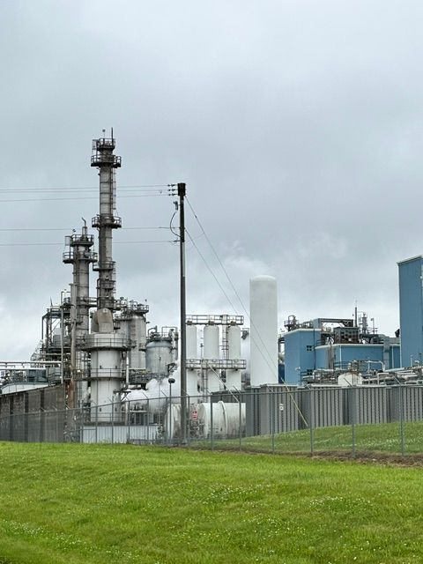
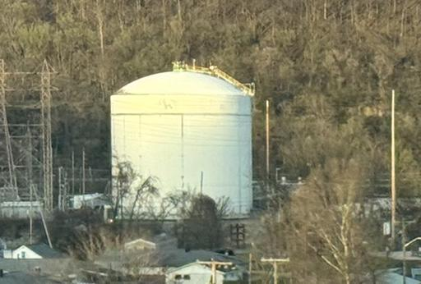
Critical Infrastructure Sector: Chemical Facilities

Slide 6
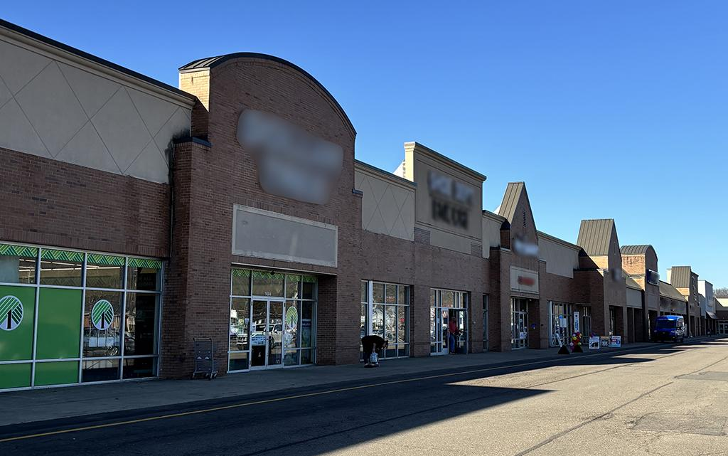

Critical Infrastructure Sector: Commercial Facilities

Slide 7
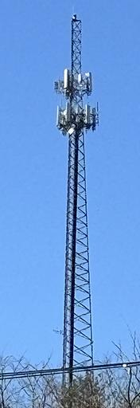
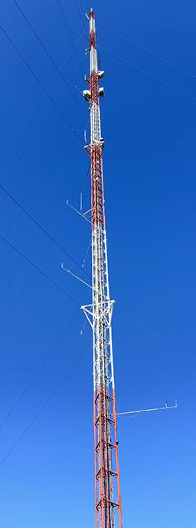
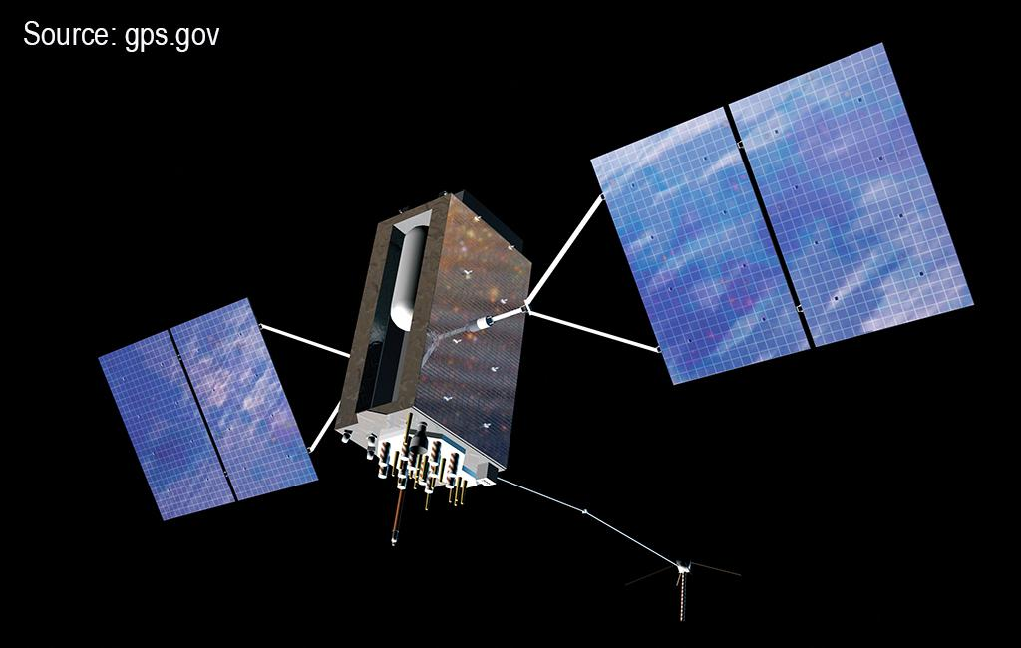
Critical Infrastructure Sector: Communications

Slide 8
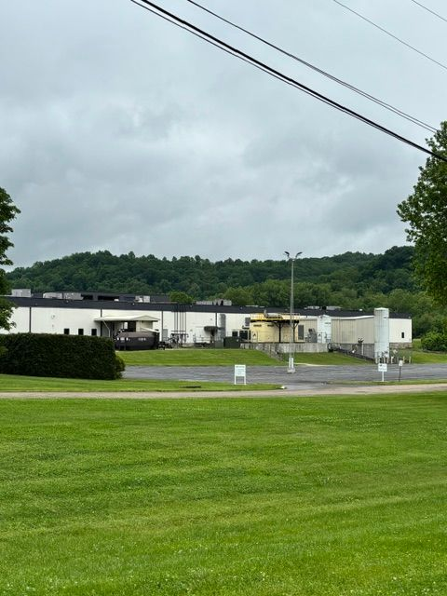
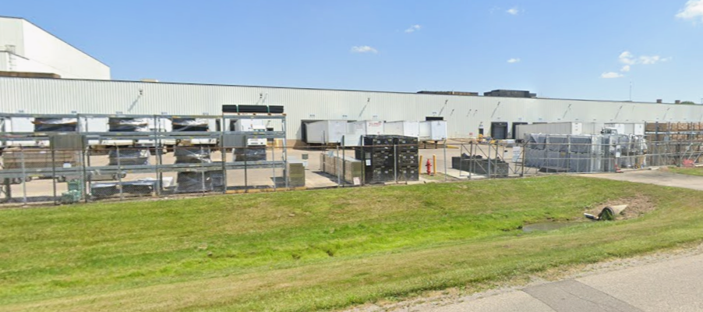
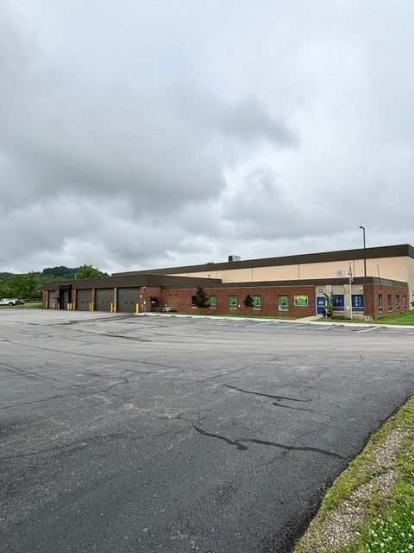
Critical Infrastructure Sector: Critical Manufacturing

Slide 9

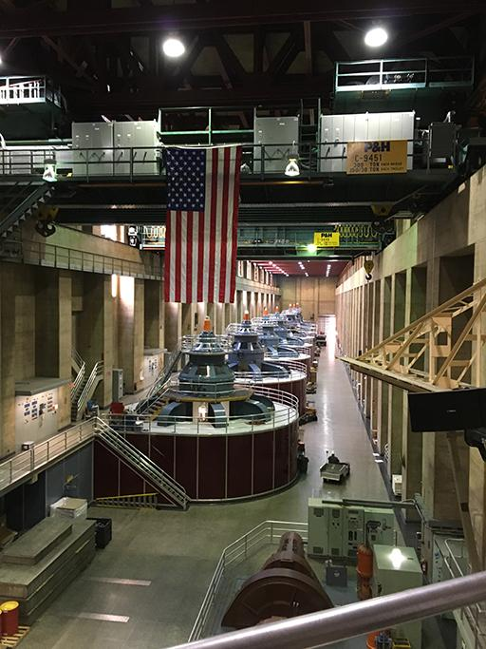
Critical Infrastructure Sector: Dams

Slide 10
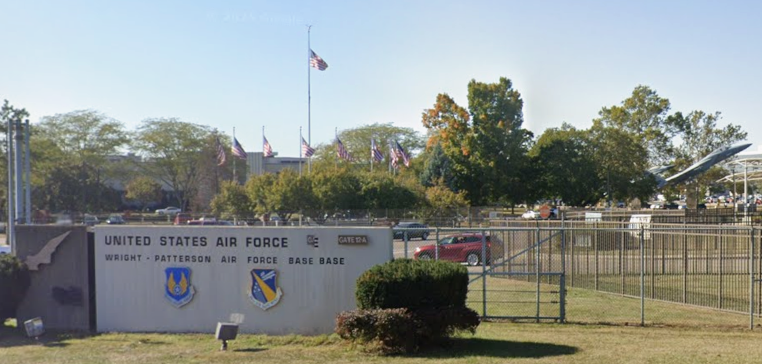
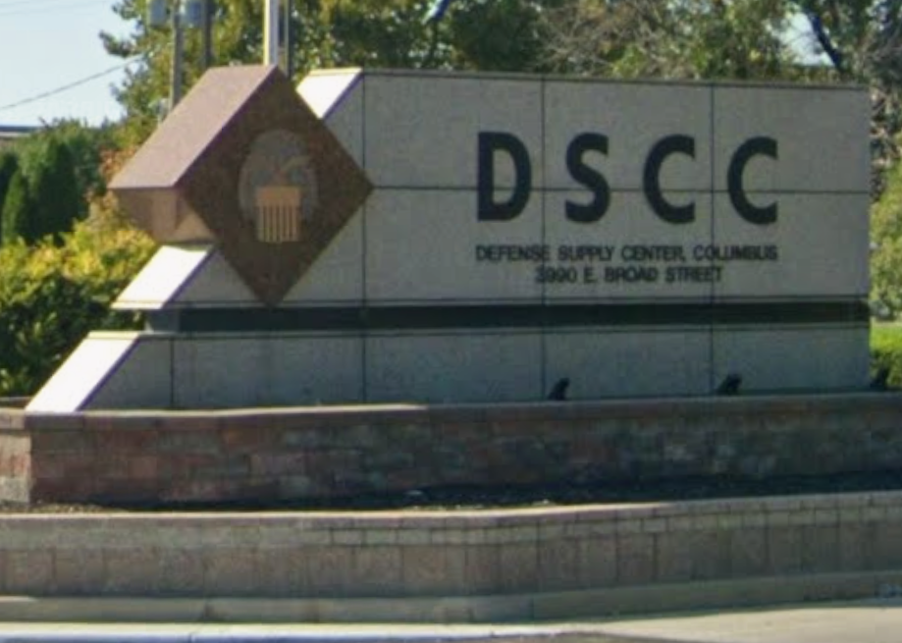
Critical Infrastructure Sector: Defense Industry

Slide 11
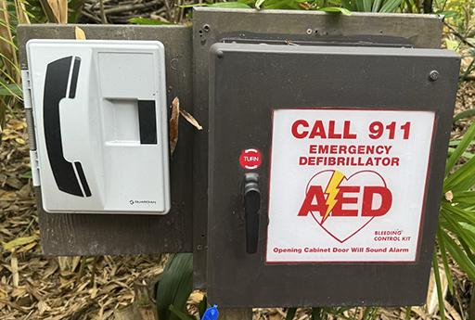
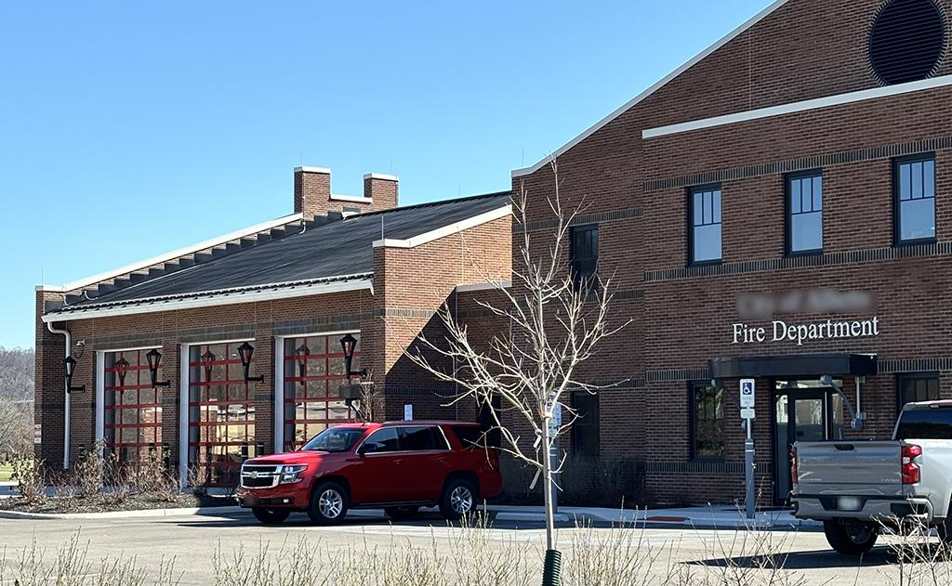
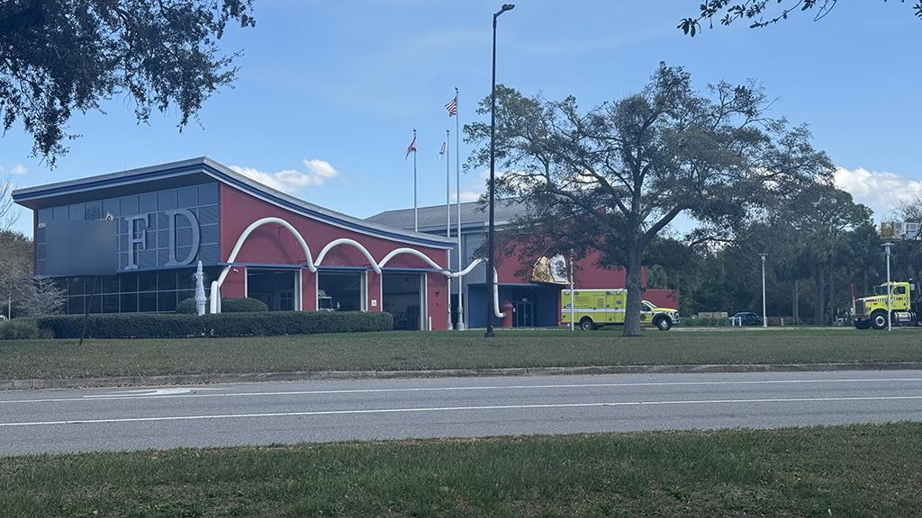
Critical Infrastructure Sector: Emergency Services

Slide 12
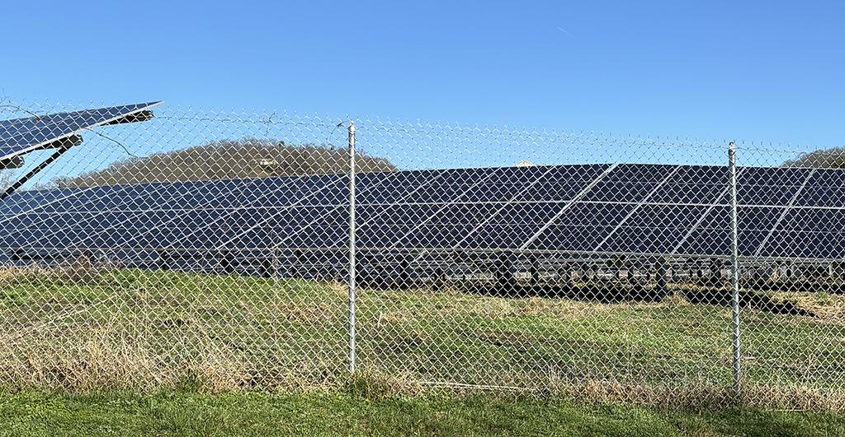
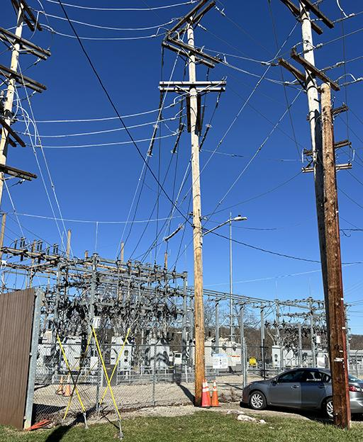
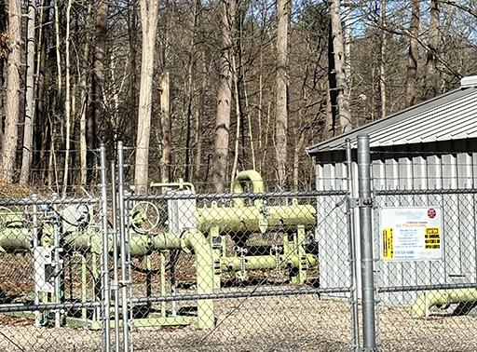
Critical Infrastructure Sector: Energy

Slide 13

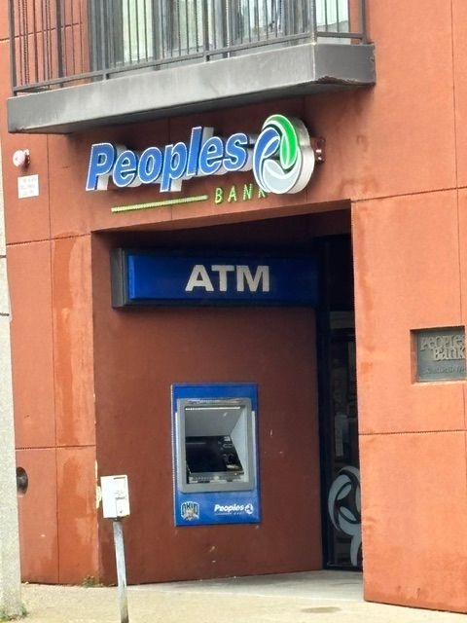
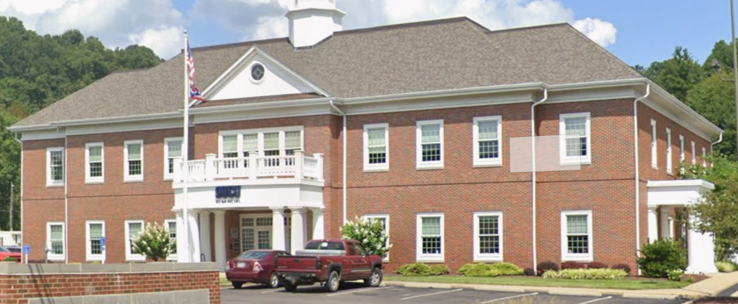
Critical Infrastructure Sector: Financial Services

Slide 14
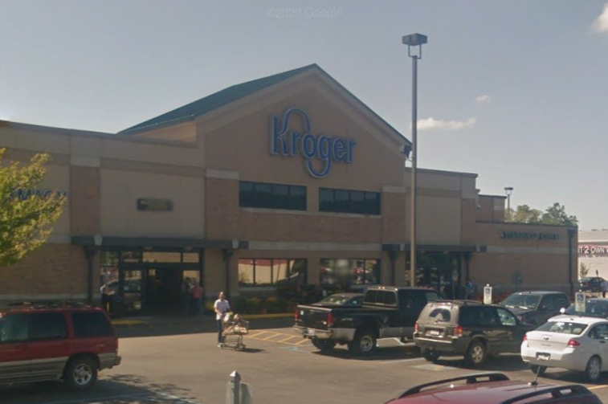
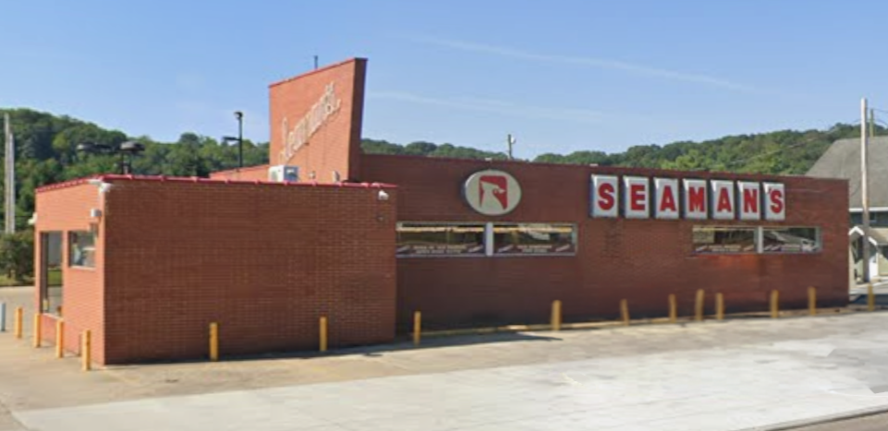
Critical Infrastructure Sector: Food & Agriculture

Slide 15

Critical Infrastructure Sector: Government Facilities

Slide 16

Critical Infrastructure Sector: Healthcare & Public Health

Slide 17
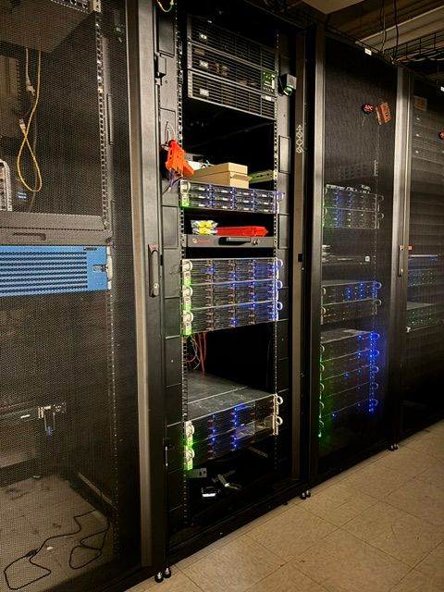
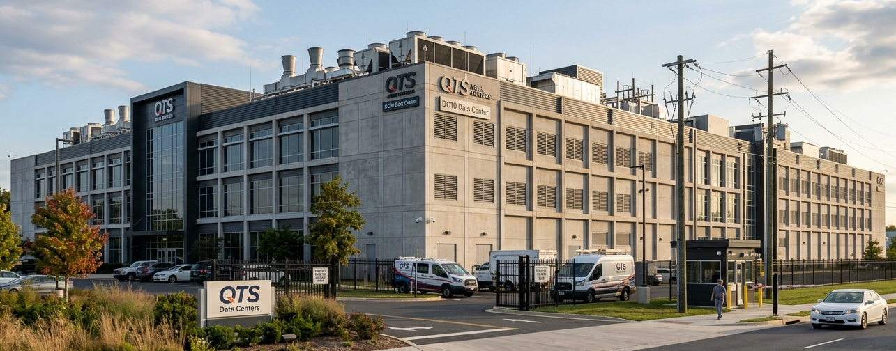
Critical Infrastructure Sector: Information Technology

Slide 18
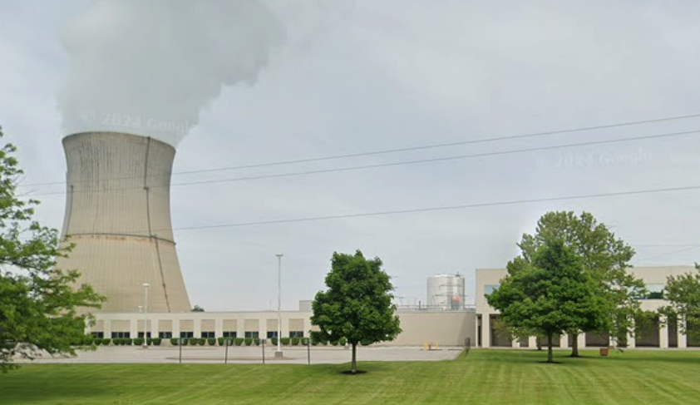
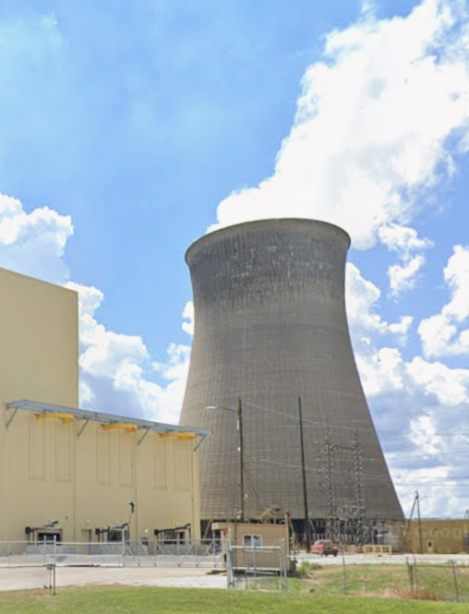
Critical Infrastructure Sector: Nuclear Reactors, Materials

Slide 19
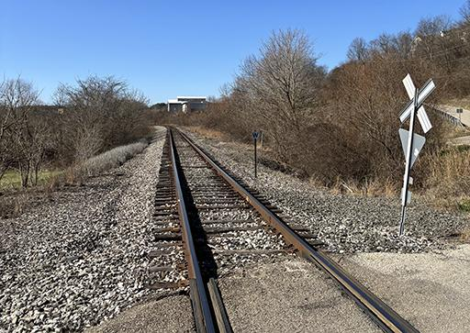
Critical Infrastructure Sector: Transportation Systems

Slide 20
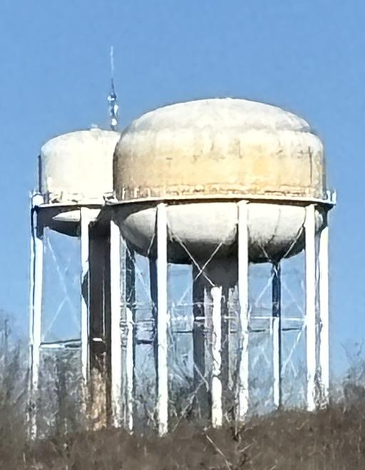
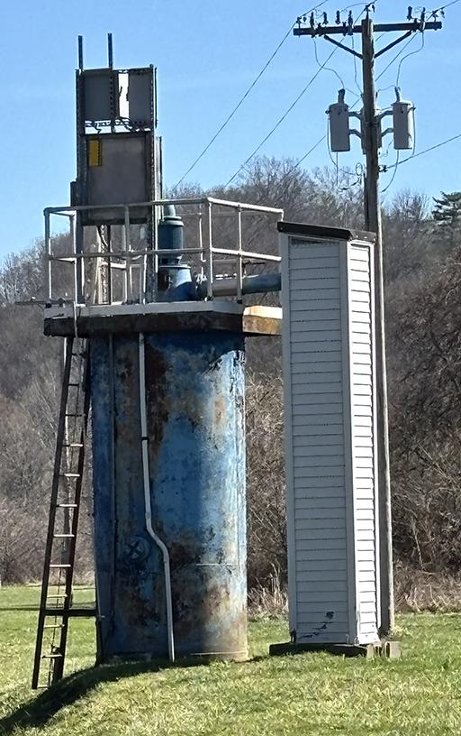
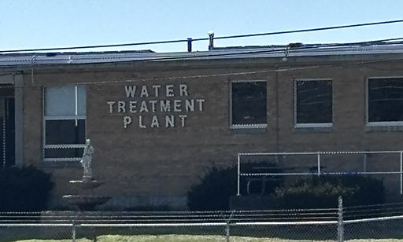
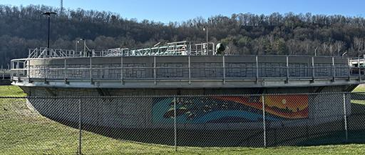
Critical Infrastructure Sector: Water & Wastewater

Slide 21
Critical Infrastructure Sectors:
Chemical
Commercial
Communications
Critical Manufacturing
Dams
Defense Industry
Emergency Services
Energy
Financial Services
Food & Agriculture
Government Facilities
Healthcare & Public Health
Information Technology
Nuclear Reactors, Materials
Transportation Systems
Water & Wastewater
Discussion: What are possible effects of the destruction or interruption of facilities and services in these sectors?

Slide 22
Operational Technologies: Devices
Sensor
  Monitors a physical condition and converts it into a signal.
  Examples: Temperature, Pressure, Proximity, Flow, Smoke
Actuator
  Receives a signal and performs some physical action.
  Example: Opens/Closes a Valve, Moves a Conveyor Belt, Pumps Water, Robotic Arm
Control Loop
  A recurring cycle that monitors, evaluates, and acts if needed.
  Physical World > Sensor > Control System > Actuator > Physical World

Slide 23
Operational Technologies: Control Loop Demonstration
Give the Control Loop Demonstration
  Show the sensor details.
  Show the actuator details.
  Show the system sensing and activating.
  Show the effects of physical tampering.
https://www.its.ohio.edu/tong/control-loop/hvac-control-loop.html

Slide 24
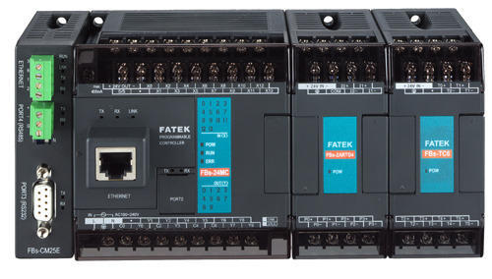
Operational Technologies: Devices
Programmable Logic Controller (PLC)
  Controls a specific process in real time. Reads sensors; drives actuators.
  Programmed via Ladder Logic and/or Structured Text (similar to Pascal)
  Detects voltages on Input Wires (Signals from Equipment)
  Sets voltages on Output Wires (Signals to Equipment)
  Makes Decisions, Runs Counters, Runs Timers
  Notice the Ethernet Port -- Communicates

Slide 25
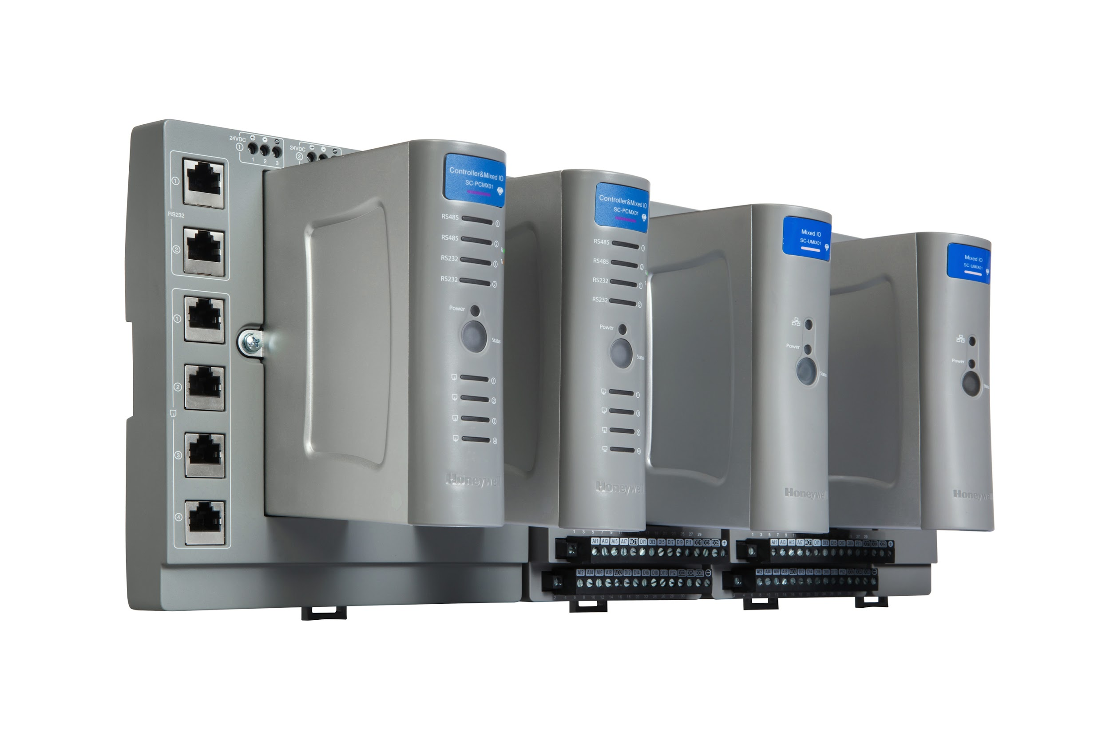
Operational Technologies: Devices
Remote Terminal Unit (RTU)
  Used in remote locations to collect data and receive commands.
  Has long-distance communication features; tolerates unreliable power.
  There can be PLC's plugged into an RTU or the RTU might have PLC capabilities.
Intelligent Electronic Device (IED)
  Like a PLC, makes quick decisions to control electrical power systems.
  Like an RTU, monitors, measures, and communicates while operating remotely.

Slide 26
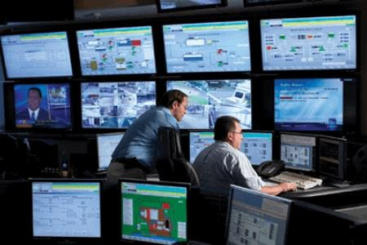
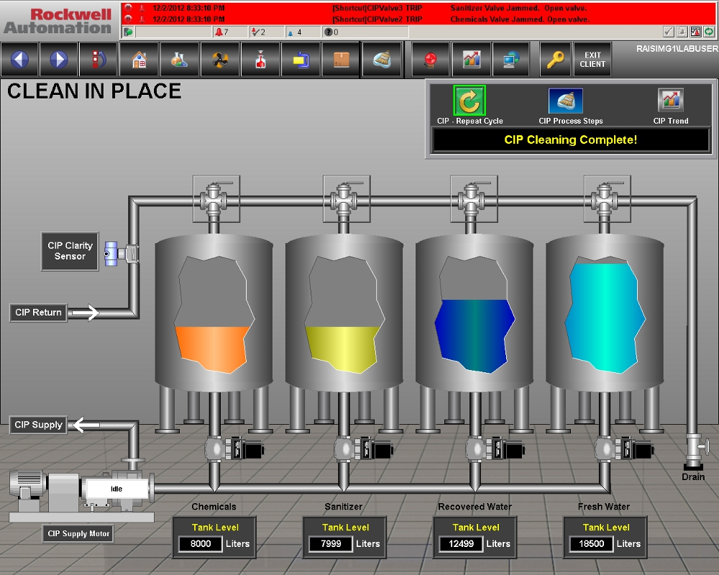
Operational Technologies: Devices
Supervisory Control and Data Acquisition (SCADA)
  Collects data from field devices (RTUs, PLCs) via an MTU.
  Issues commands to field devices.
    High level commands, not the real-time control.
    The local PLCs take care of getting the work done via their programming.
Human Machine Interface (HMI)
  Operator-facing interface for controlling an OT system.
  For SCADA, the HMI might be a workstation running software that shows the process.
Master Terminal Unit (MTU)
  Brokers communications to RTUs/PLCs on behalf of a SCADA system.

Slide 27
Operational Technologies: Devices
Distributed Control System (DCS)
  Think of it as a more localized SCADA system.
  Not controlling a process over a larger geographical area; a single facility.
  Capable of more real-time control.
Building Automation System (BAS)
  Manages mechanical and electrical systems within a building.
  HVAC, lighting, elevators, fire suppression, etc.
  Sometimes called a Building Control System (BCS) or Building Management System (BMS).
Physical Access Control System (PACS)
  Badge readers, electronic locks, turnstiles, etc.
  Commonly interfaces with an IT identity and access management systems.

Slide 28
Operational Technologies: Protocols
Modbus Protocol (1979)
  Simple point-to-point device communication.
Fieldbus Protocol Family (1980s-1990s)
  Devices share a common communication medium.
Significance of these protocols:
  Pervasive because devices have longevity and are expensive.
  Transfer data and commands to OT devices.
  No authentication, No authorization, No encryption

Slide 29
Operational Technologies: Programming Languages
IEC 61131-3
  An international standard for PLCs; defines programming languages for PLCs.
  Here are two, for example:
Ladder Logic
  Visually mimics electrical relay circuits, representing inputs and outputs.
  PLCs can also have timers, arithmetic operations, text processing, table lookups.
  Modbus can signal setting values in registers (memory locations) for the program to use.
Structured Text (ST or STX)
  A high-level programming language similar to Pascal.
  Better for complex logic and data management than Ladder Logic.

Slide 30
Operational Technologies: Structured Text
(* Temperature Control - Simple On/Off *)
IF roomTemperature < setPoint THEN
heaterOn := TRUE;
ELSE
heaterOn := FALSE;
END_IF;

Slide 31
Operational Technologies: Ladder Logic Example
Here's the same program in Ladder Logic:
| [CMP] |
| roomTemperature < setPoint HEATER_ON |
|--------[<]---------------------------( )--------------|

Slide 32
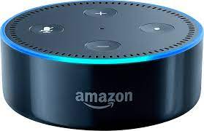
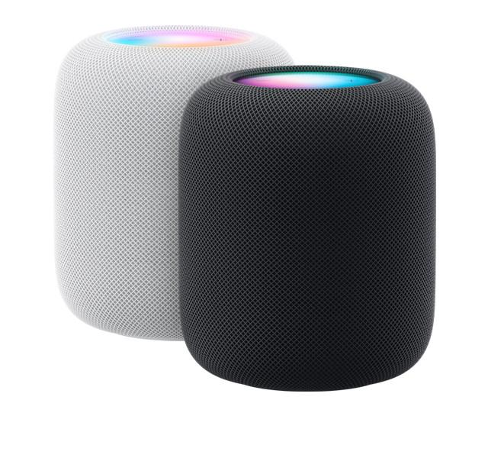
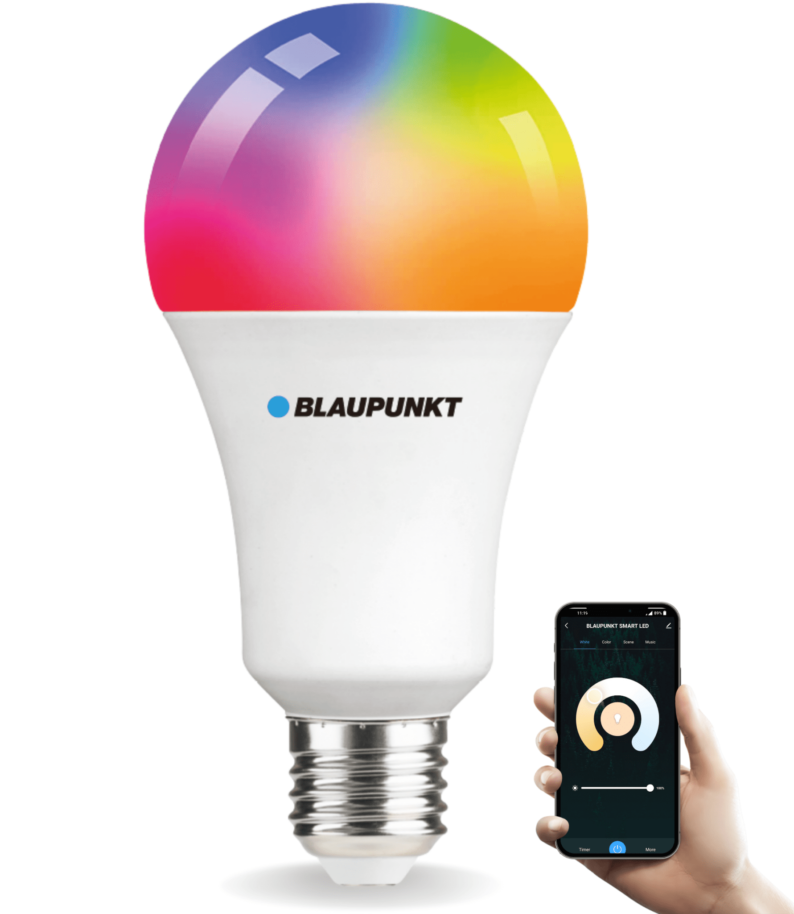
Operational Technologies: Devices
Internet of Things (IOT)
  Network-connected (possibly Internet-connected) "everyday" physical devices.
  Smart thermostats, TVs, fitness trackers, appliances, etc.
Industrial Internet of Things (IIOT)
  Same concept as IOT, but with industrial devices.
  Overlaps with classic sensor, actuator, PLC, RTU, IED, and HMI functionality.
Significance?
  Uses Internet protocols to communicate rather than classic OT protocols, such as TCP/IP.
  Uses classic IT programming languages and computing environments, such as Linux.
  IT vulnerabilities can then affect OT environments.

Slide 33
Operational Technologies: Digital Twins
Digital Twins
  A virtual replica of a physical system, component, or process.
  A realistic simulation; not a demonstration
    Behavior based on real-world modeling.
    Connectivity to real systems to send / receive data and commands.
Uses:
  Research - Probe for vulnerabilities when you can't afford a second production facility.
    Real PLCs connected to simulated sensors, actuators, and command networks.
  Maintenance - Apply real-world data to a digital twin to monitor usage, schedule maintenance.
    Run a digital twin for each airplane engine in the fleet fed by real-time flight data.

